Slide 1
O11y with Toli
102 - June 2022
Choosing Traces over Logs

Slide 2
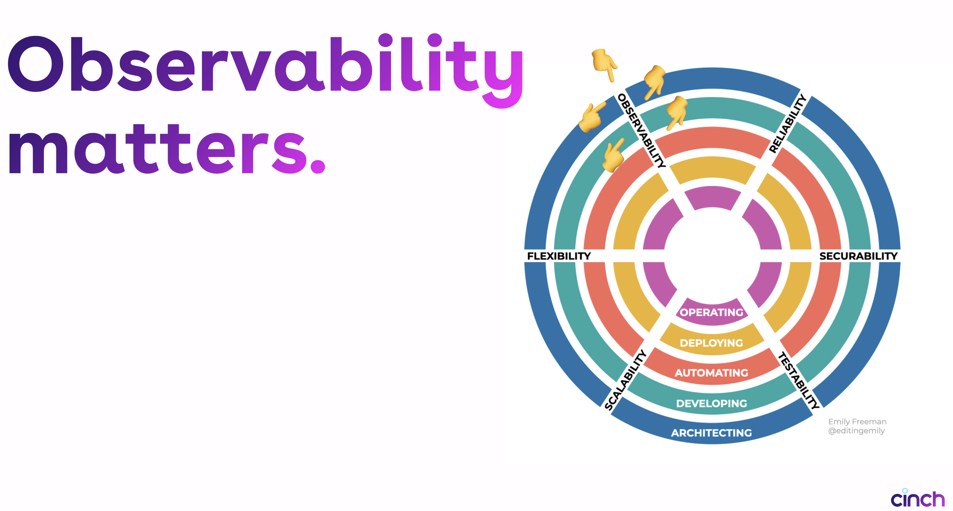
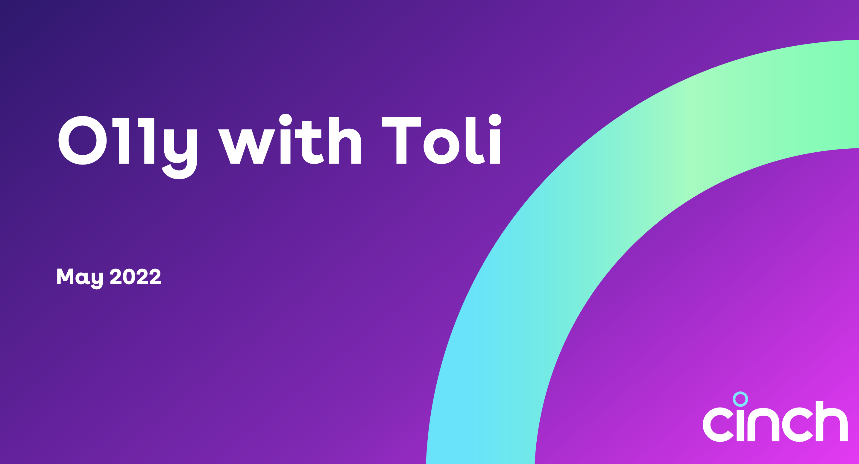
Huh?!

Slide 3
O11y with Toli
👉
102 - June 2022
Choosing Traces over Logs

Slide 4
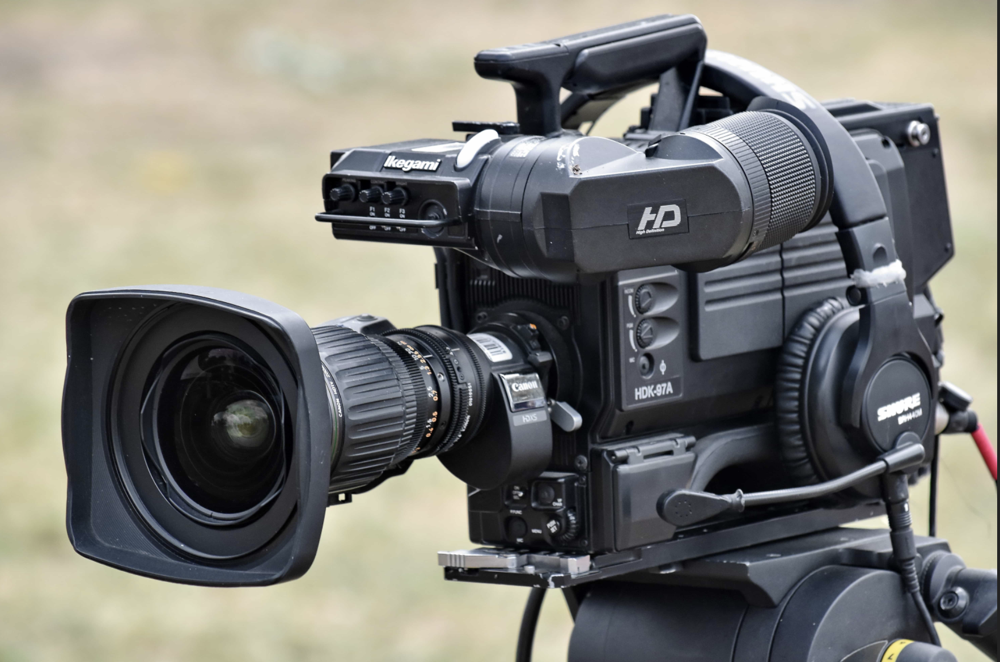


Slide 5
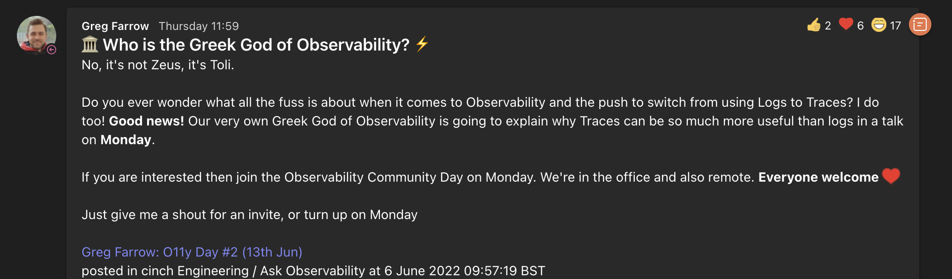
👉

Slide 6
“That's how excited people are about learning about logs”

Slide 7
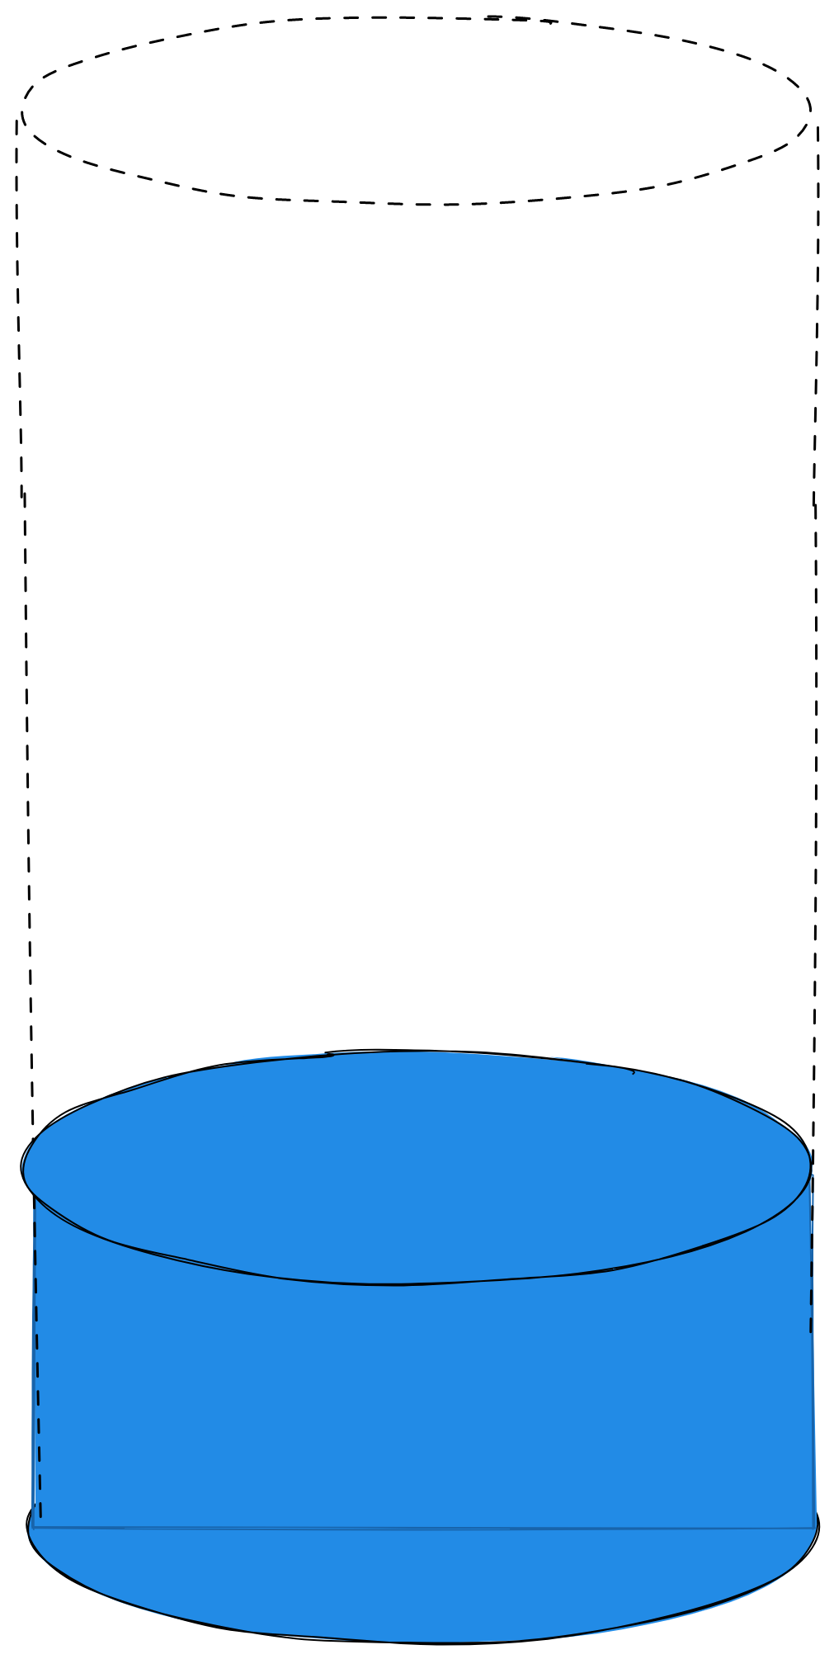
Cognitive (observability) Load
Thinking

Slide 8
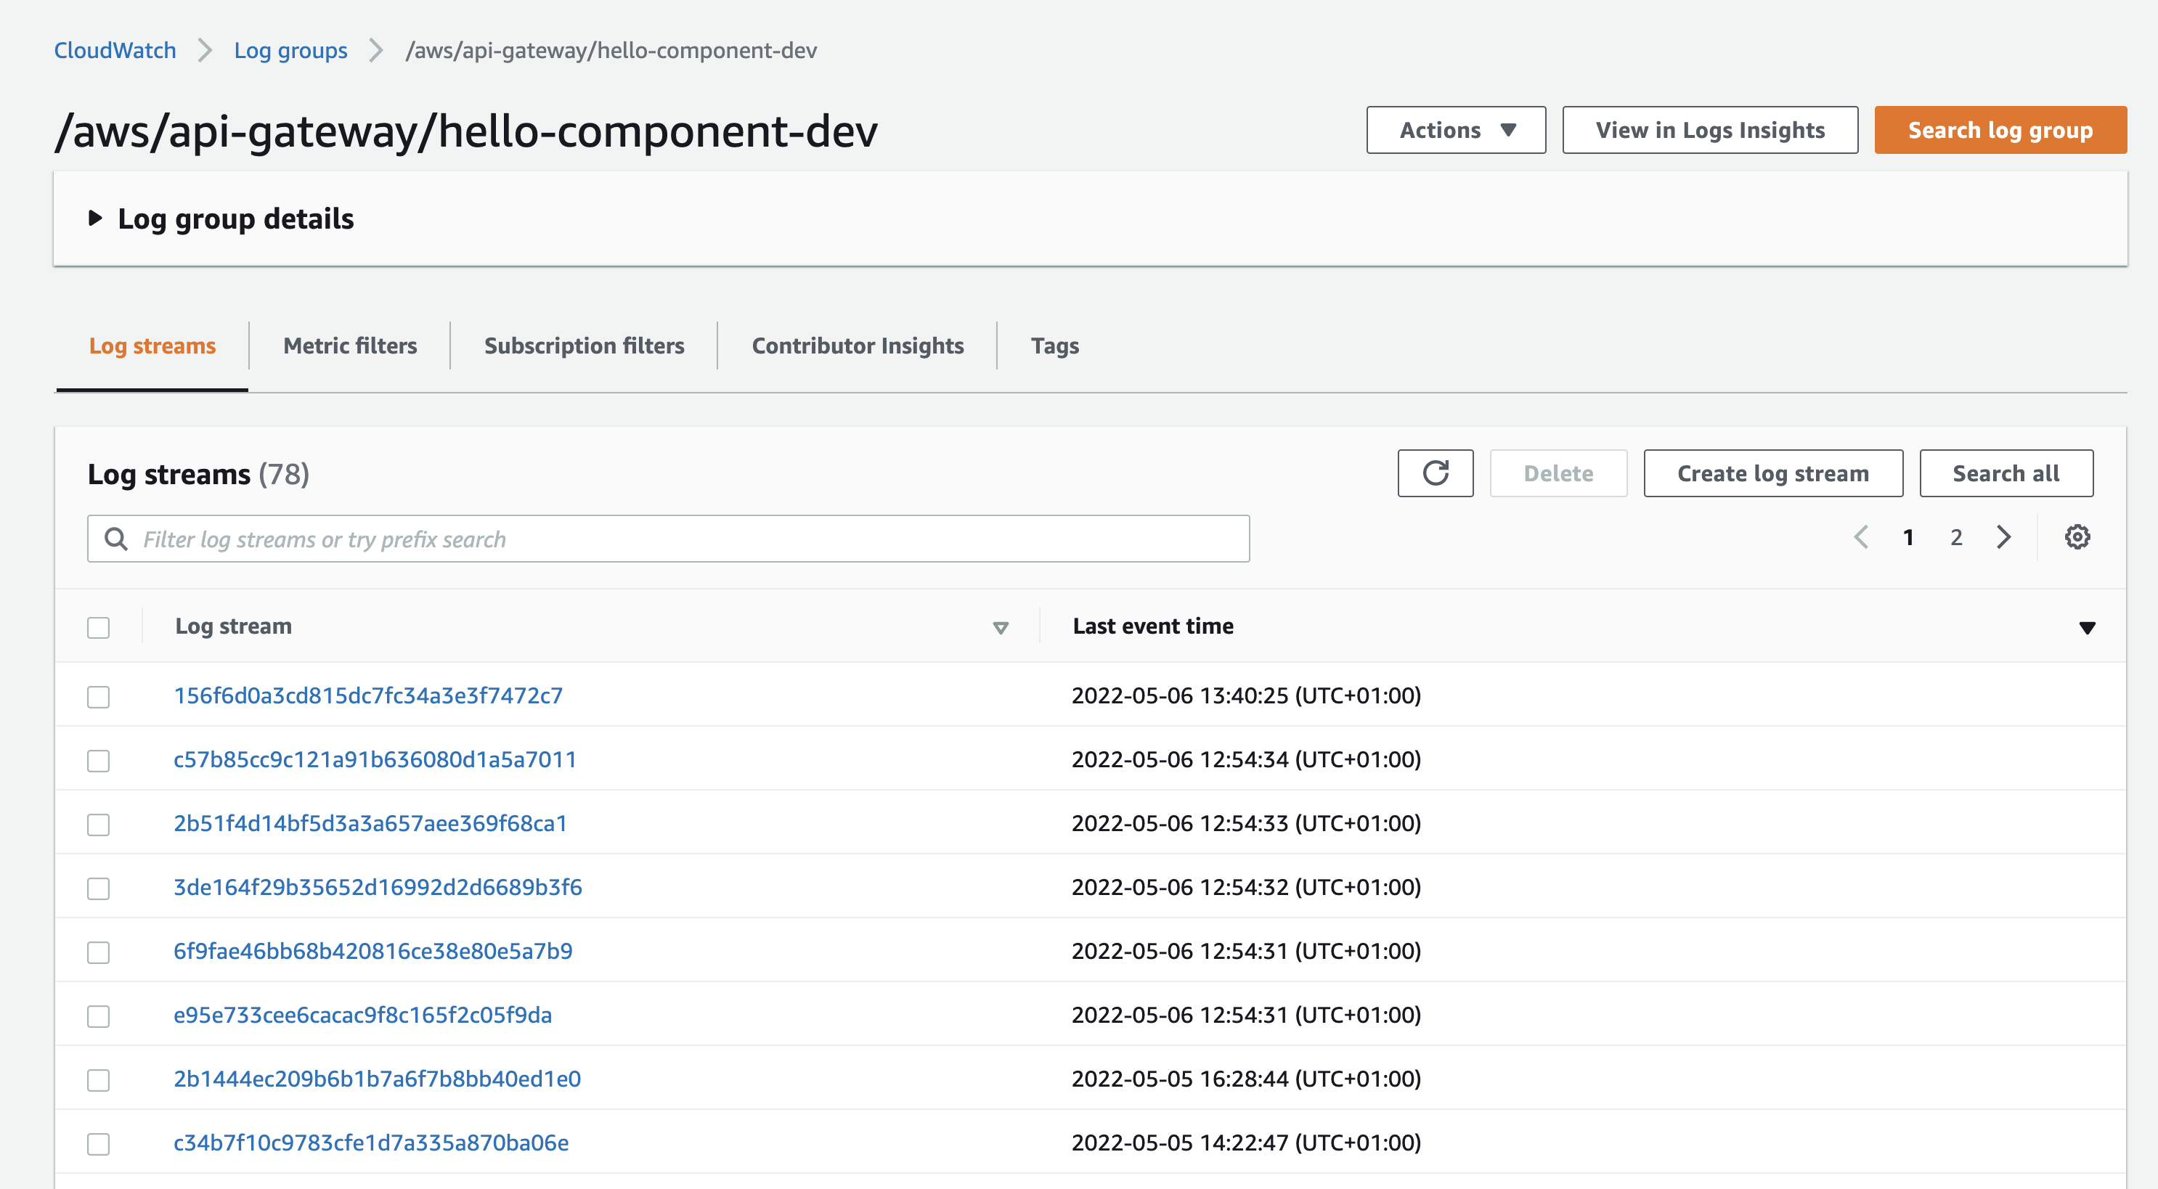
Which GUID is mine?

Slide 9

Which GUID is mine?

Slide 10
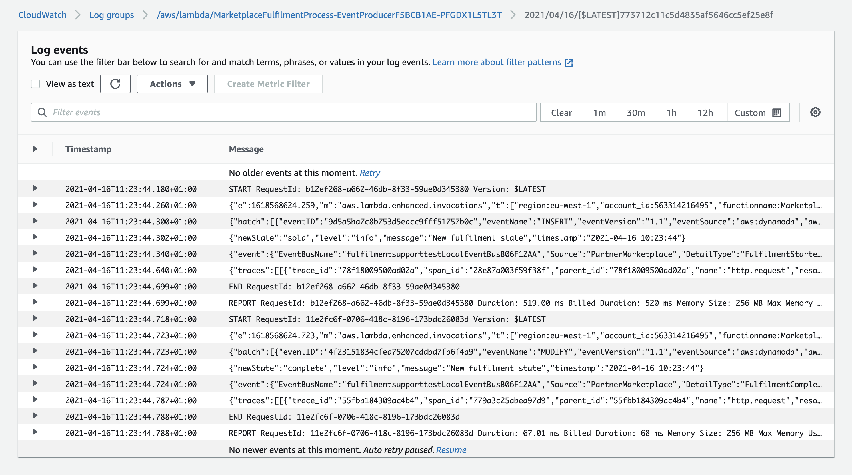
Random message hell

Slide 11
Random message hell
START
END
REPORT

Slide 12
Random message hell
👉
START
👉
END
REPORT

Slide 13
Getting insights doesn’t need to be this hard.

Slide 14
It can be pretty. And elegant. And fun.

Slide 15
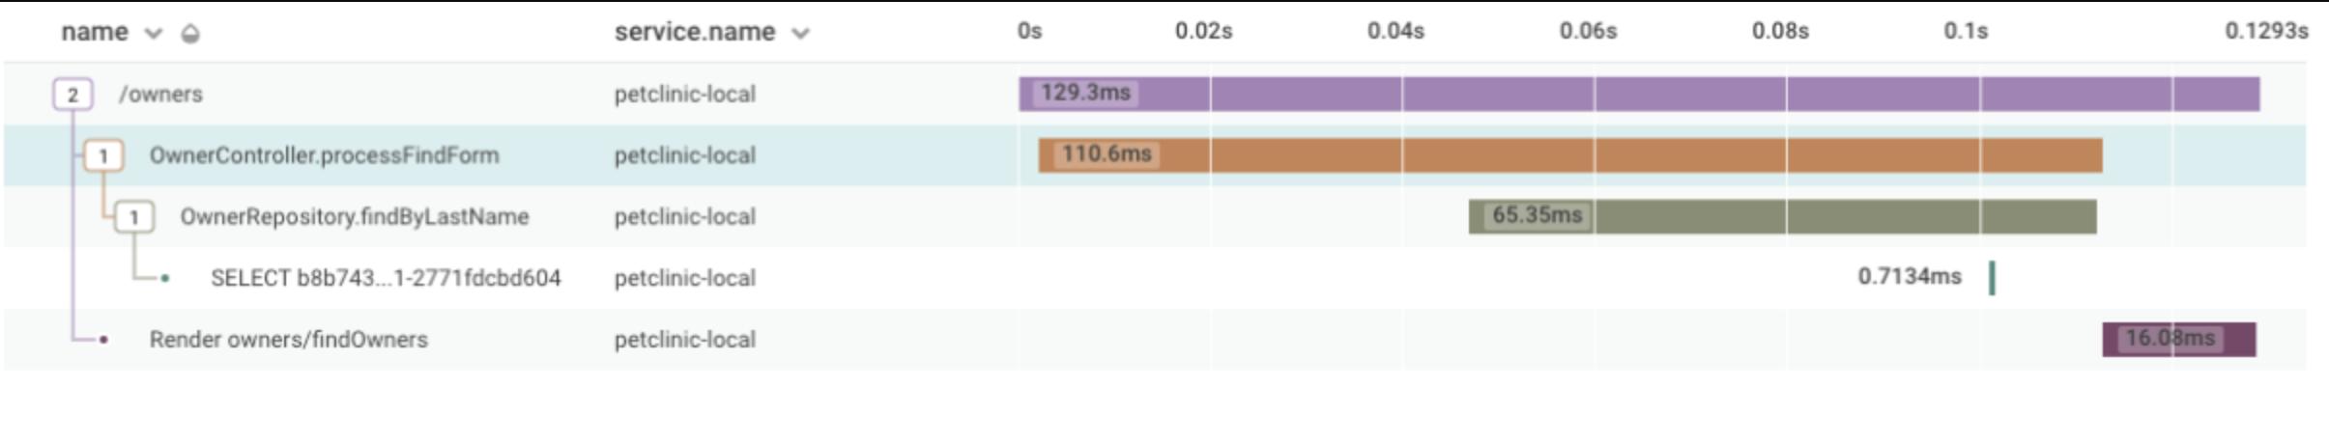

Slide 16
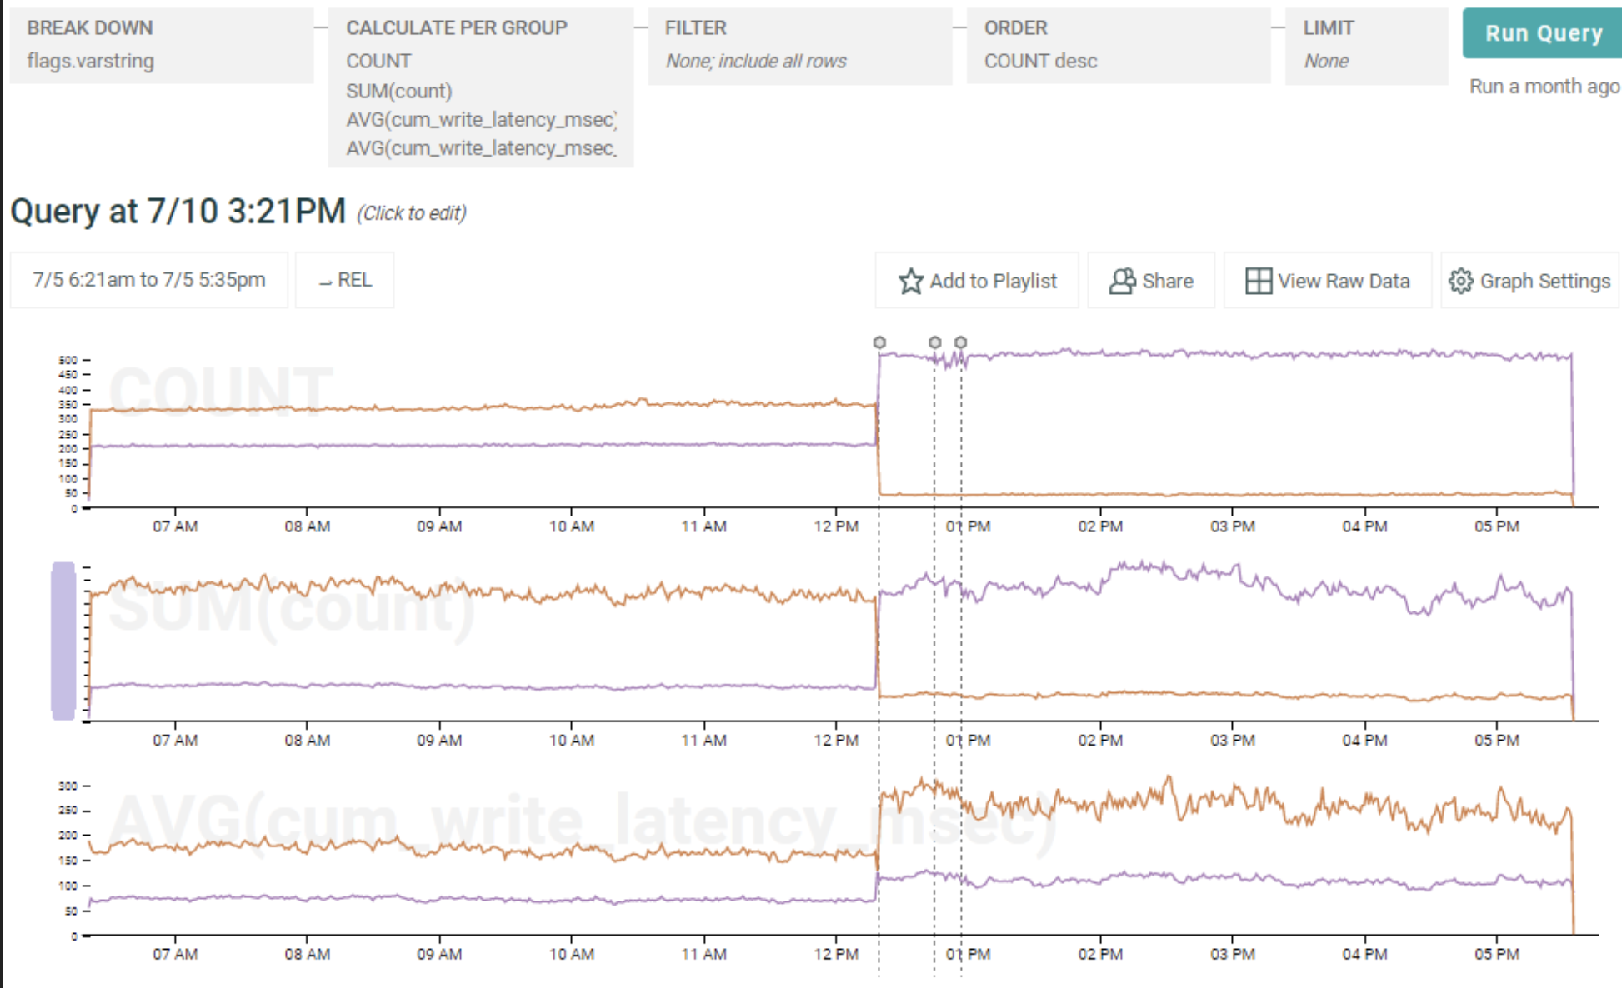

Slide 17
You will want to put Observability concepts on your CV.

Slide 18
What are the competing observability ideologies?

Slide 19
What are the competing observability ideologies?
What are Logs, Metrics and Traces?

Slide 20
What are the competing observability ideologies?
What are Logs, Metrics and Traces?
Why are Traces so much better than Logs?

Slide 21
What telemetry data structures should we use?
Notes:
What’s your mental model of o11y telemetry datatypes?
Misconception: everything is just structured logging?

Slide 22

What telemetry data structures should we use?
Notes:
What’s your mental model of o11y telemetry datatypes?
Misconception: everything is just structured logging?

Slide 23
Tele
Metry
Τηλέ
Μέτρον
Remote
Measurement

Slide 24
Data structure: the ‘shape’ of the telemetry data point

Slide 25
What telemetry data structures should we use?
Notes:
What’s your mental model of o11y telemetry data structures?
Misconception: everything is just structured logging?

Slide 26
Competing ideologies

Slide 27

“Everything is an event”

Slide 28

”There are 3 pillars”

Slide 29
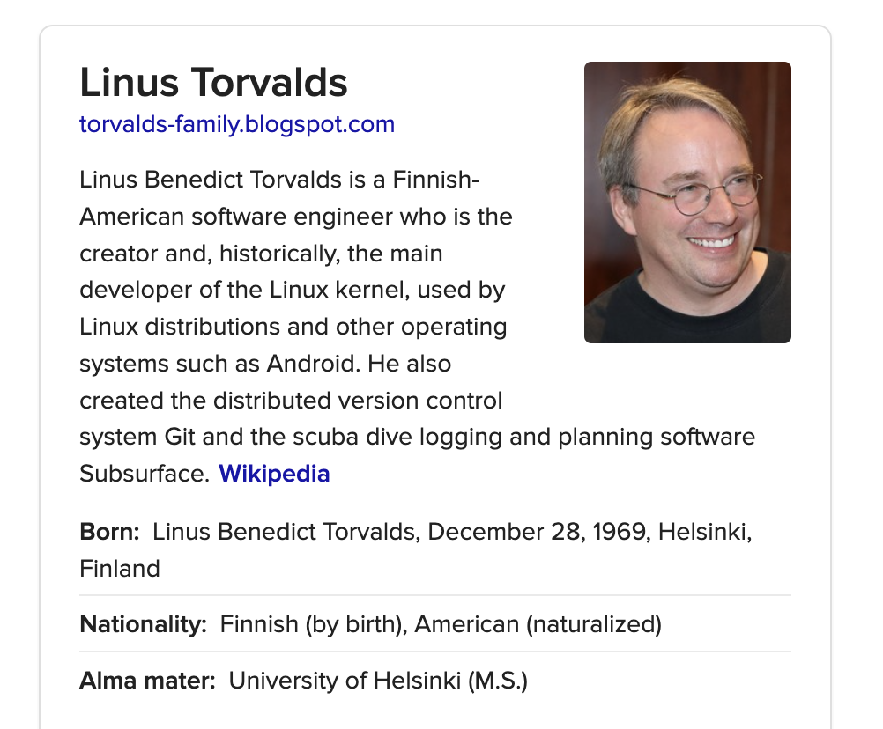
”Just log it out”

Slide 30
Events
vs
3 Pillars
vs
Logs

Slide 31

Traces
Logs
Metrics

Slide 32
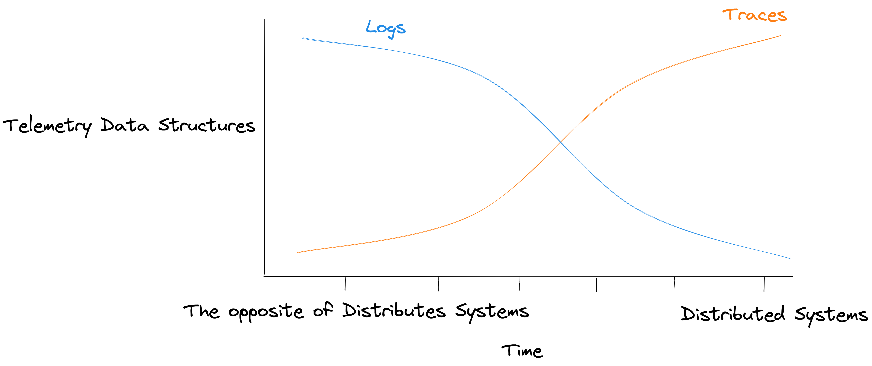

Slide 33
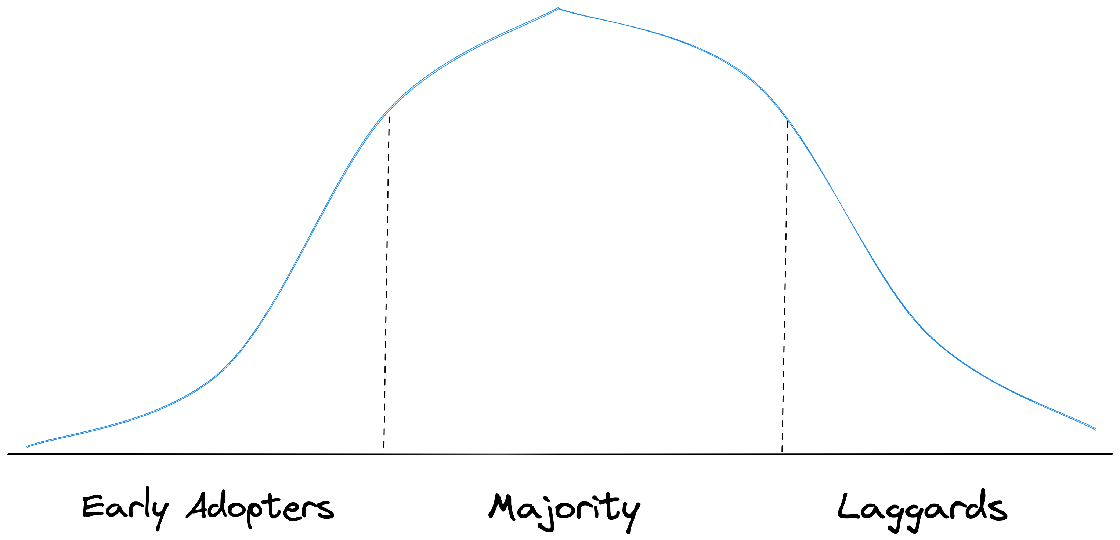
Logs
3 pillars
Events

Slide 34

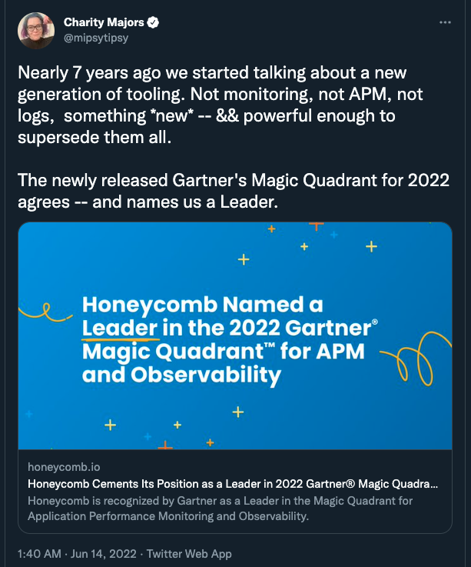
Logs
3 pillars
Events

Slide 35
We started from Logs
Notes:
What’s your mental model of o11y telemetry datatypes?
Misconception: everything is just structured logging?

Slide 36
Logs
3 pillars
👉
👉
Events

Slide 37
An event log is an immutable, timestamped record of discrete events that happened over time.*

Slide 38
Plain Text
Structured
Binary

Slide 39
log.info(“We have sold a car!”)
log.info(“We have sold a car!”, vehicle.id)
dsmfkdmakfmkdmkfmqewkm

Slide 40
log.info(“Customer is requesting to sell a car!”)
If (carSold)
log.info(“We have sold a car!”)
Else
log.info(“Oops we didn’t sell a car!”)

Slide 41
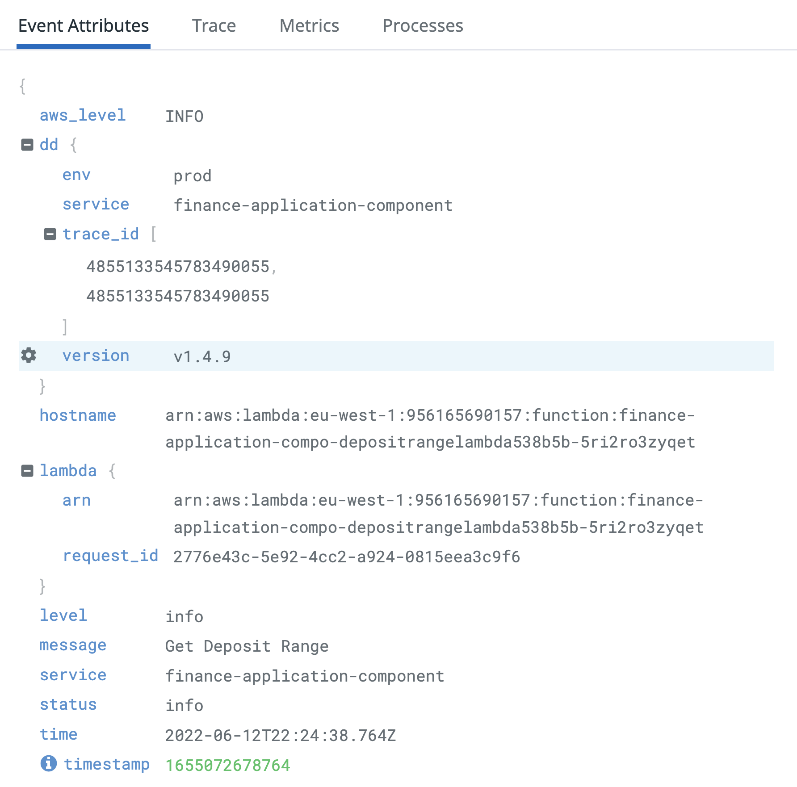
Log Context

Slide 42
Cognitive (observability) Load
Thinking
Logs

Slide 43
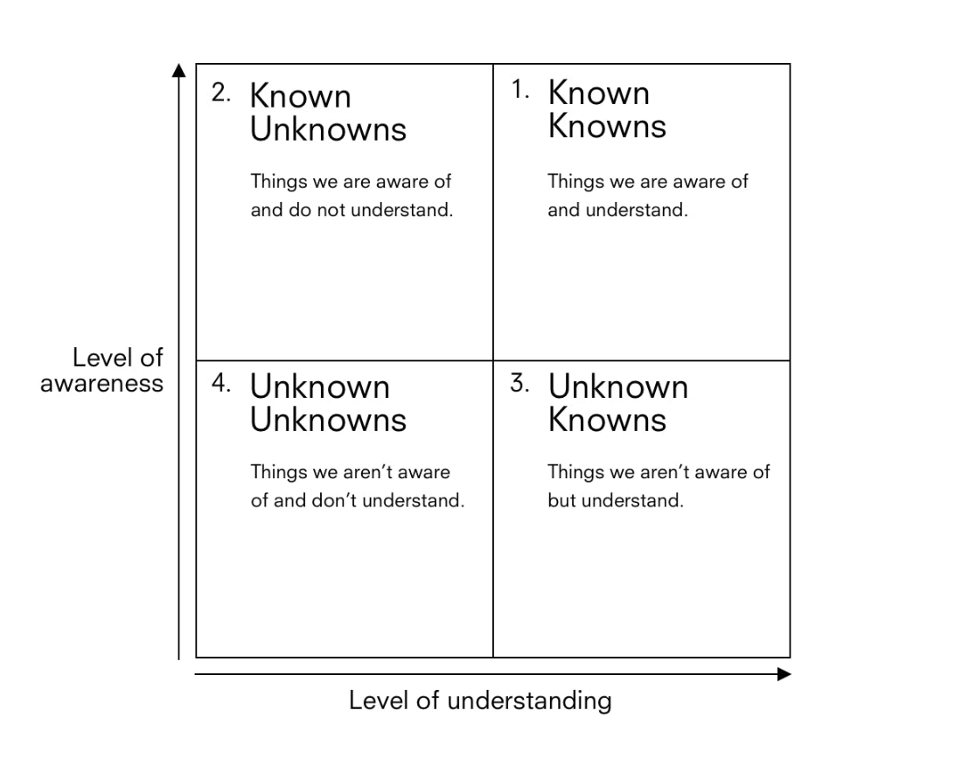


Slide 44
From Logs to Traces
Notes:
What’s your mental model of o11y telemetry datatypes?
Misconception: everything is just structured logging?

Slide 45
Logs
👉
👉
3 pillars
Events

Slide 46
Traces
Logs
Metrics

Slide 47
👉
👉
Traces
👉
👉
Logs
Metrics

Slide 48
Traces
Logs
Metrics

Slide 49
Metrics are a numeric representation of data measured over intervals of time.

Slide 50
Metrics can harness the power of mathematical modeling and prediction to derive knowledge of the behavior of a system over intervals of time in the present and future.

Slide 51
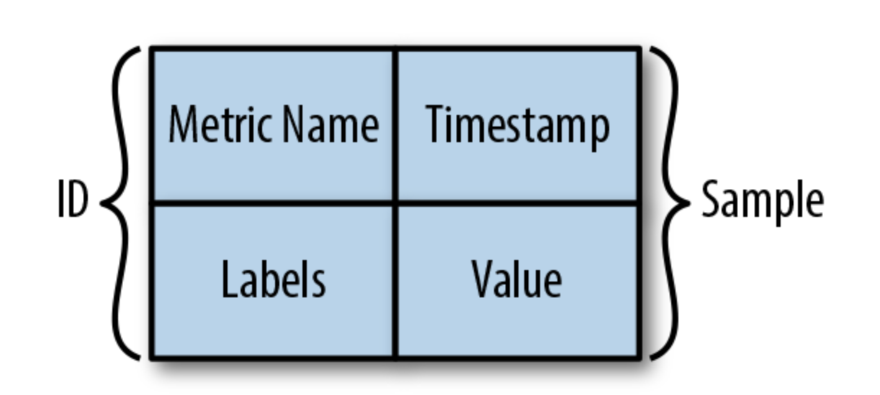

Slide 52
sendMetric( metric_name: “cars_sold”, number_of_cars_sold: 1, tags: “service:car-seller”)

Slide 53
Traces
Logs
Metrics

Slide 54
A trace is a representation of a series of causally related distributed events that encode the end-to-end request flow through a distributed system.

Slide 55
A trace is a representation of a series of causally related distributed events that encode the end-to-end request flow through a distributed system.

Slide 56
👉
👉

Slide 57
Traces are used to identify the amount of work done at each layer while preserving causality by using happens-before semantics.

Slide 58
Traces are used to identify the amount of work done at each layer while preserving causality by using happens-before semantics.

Slide 59
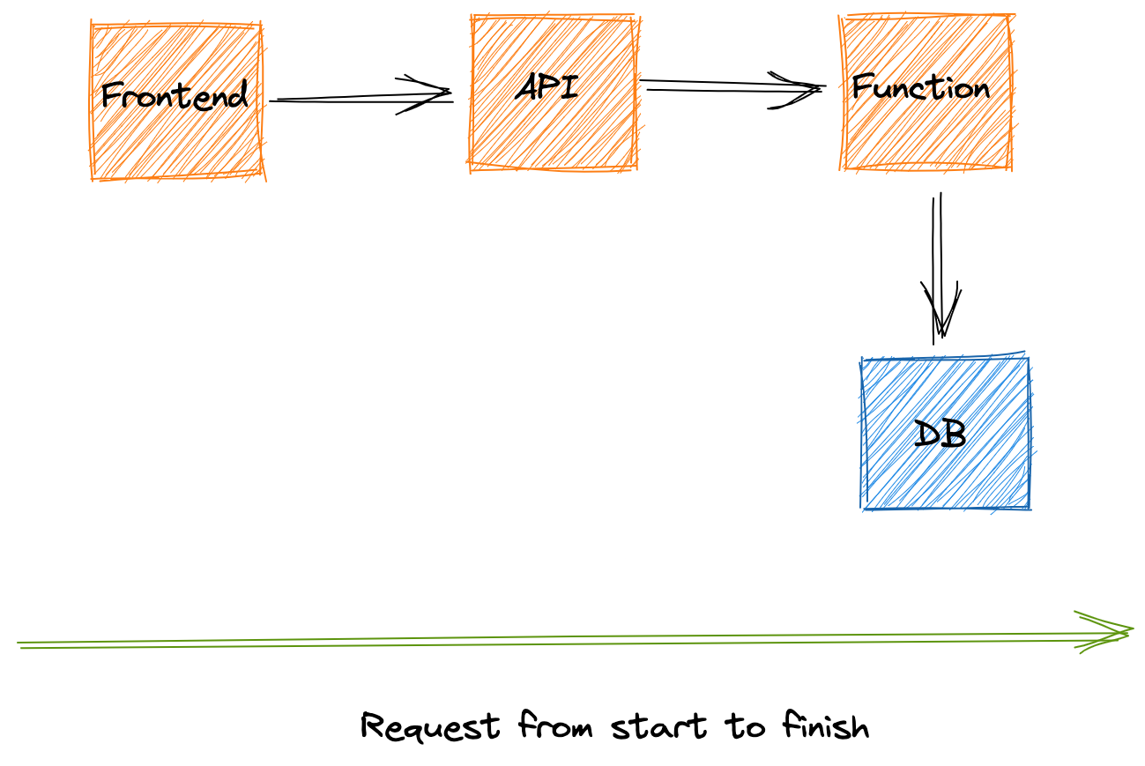

Slide 60
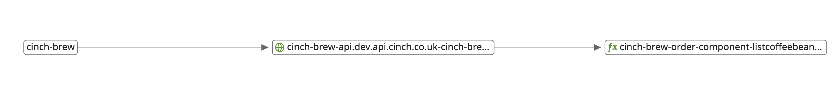

Slide 61
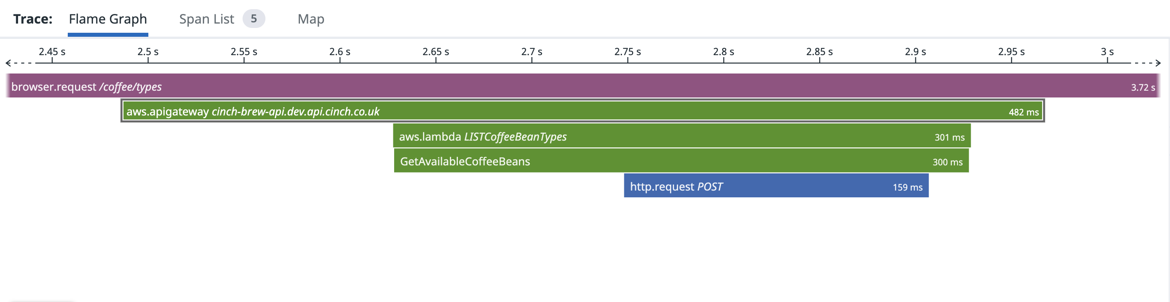

Slide 62
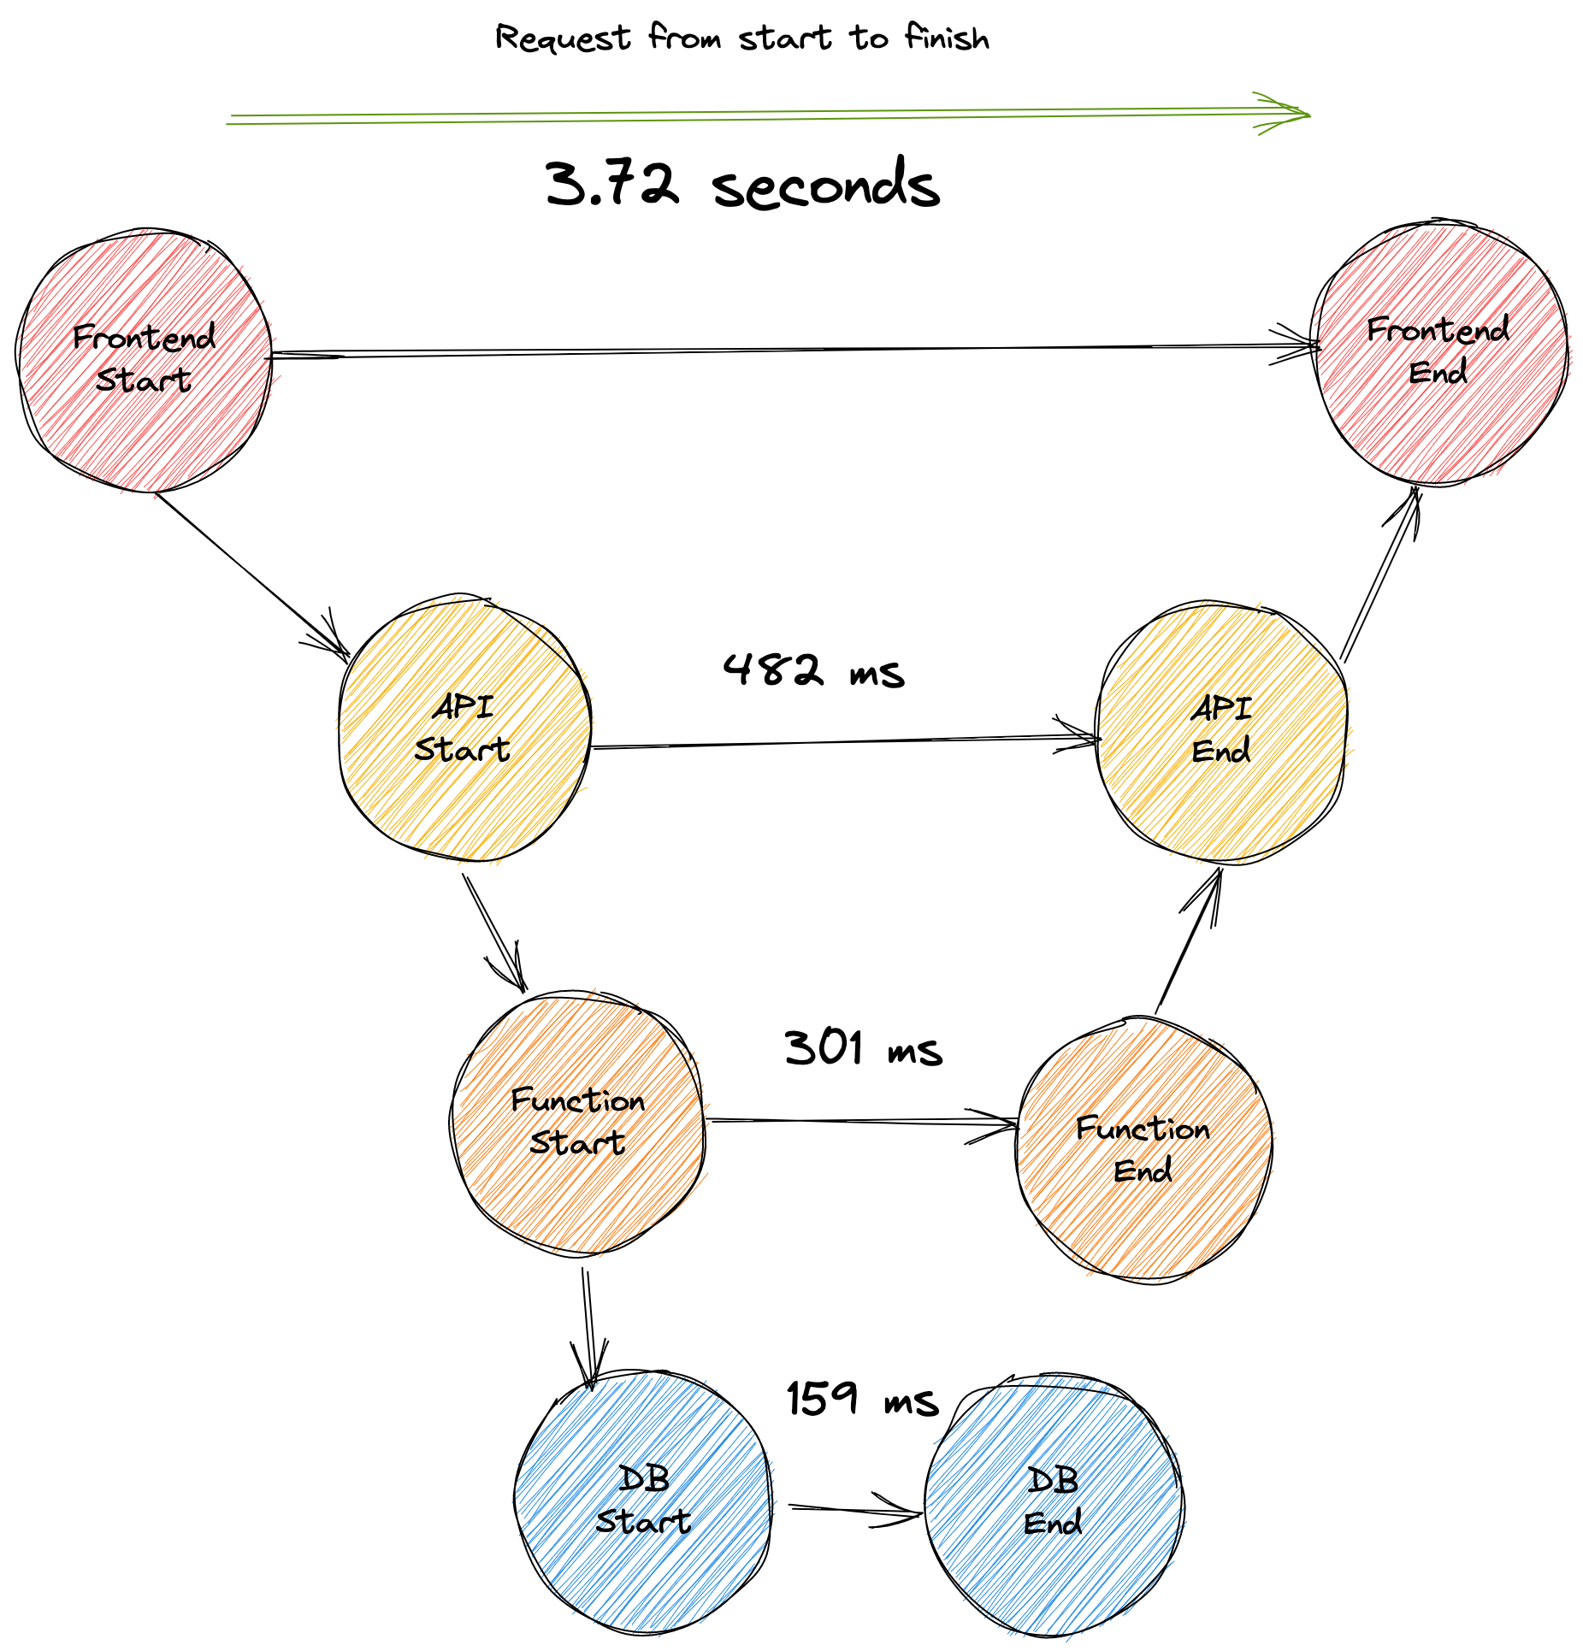

Slide 63
Traces are used to identify the amount of work done at each layer while preserving causality by using happens-before semantics.

Slide 64
Amount of work
👉
👉
👉
👉

Slide 65
Preserving causality
👉
👉
👉
👉
👉

Slide 66
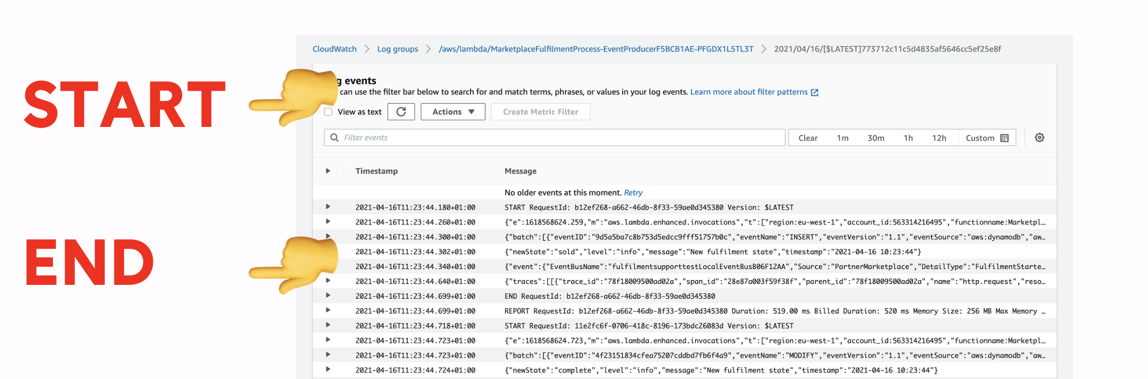

Slide 68
A trace is a directed acyclic graph (DAG) of spans*, where the edges between spans are called references.
*hold tight, I’ll explain.

Slide 69
Span*
Span
Span
Span

Slide 70
Span*
Span
*a ‘hop’ along the flow
Span
Span

Slide 71
Span*
Span
*a ‘hop’ along the flow
Span
Span

Slide 72
A reference
👉

Slide 73
A reference
👉
👉
Another reference

Slide 74
A directed acyclic graph (DAG) because…

Slide 75
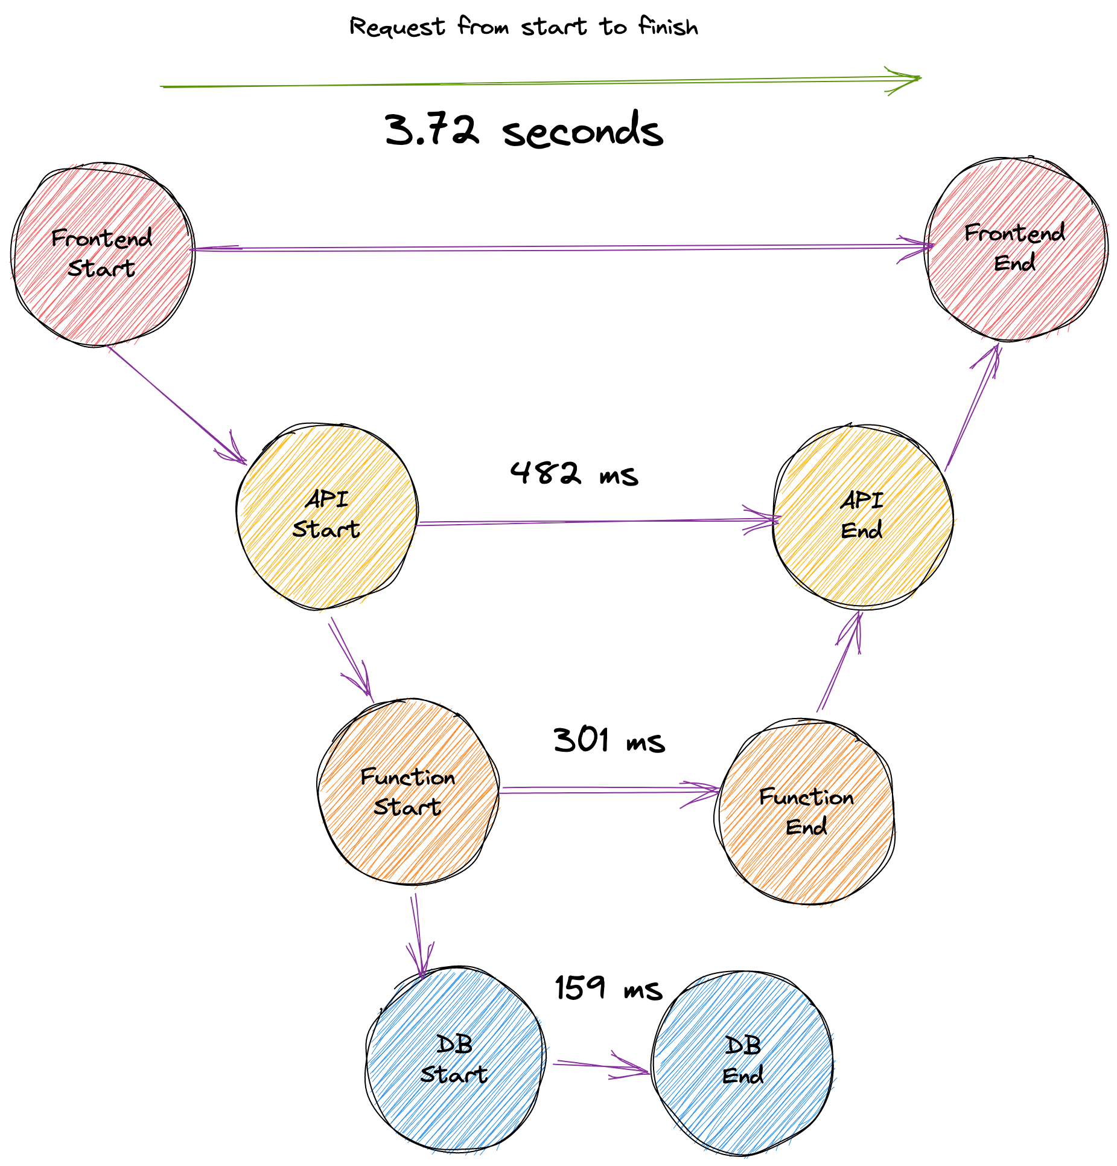
A directed acyclic graph (DAG) because…
It goes in one single direction.
👉
👉
👉
👉
👉

Slide 76
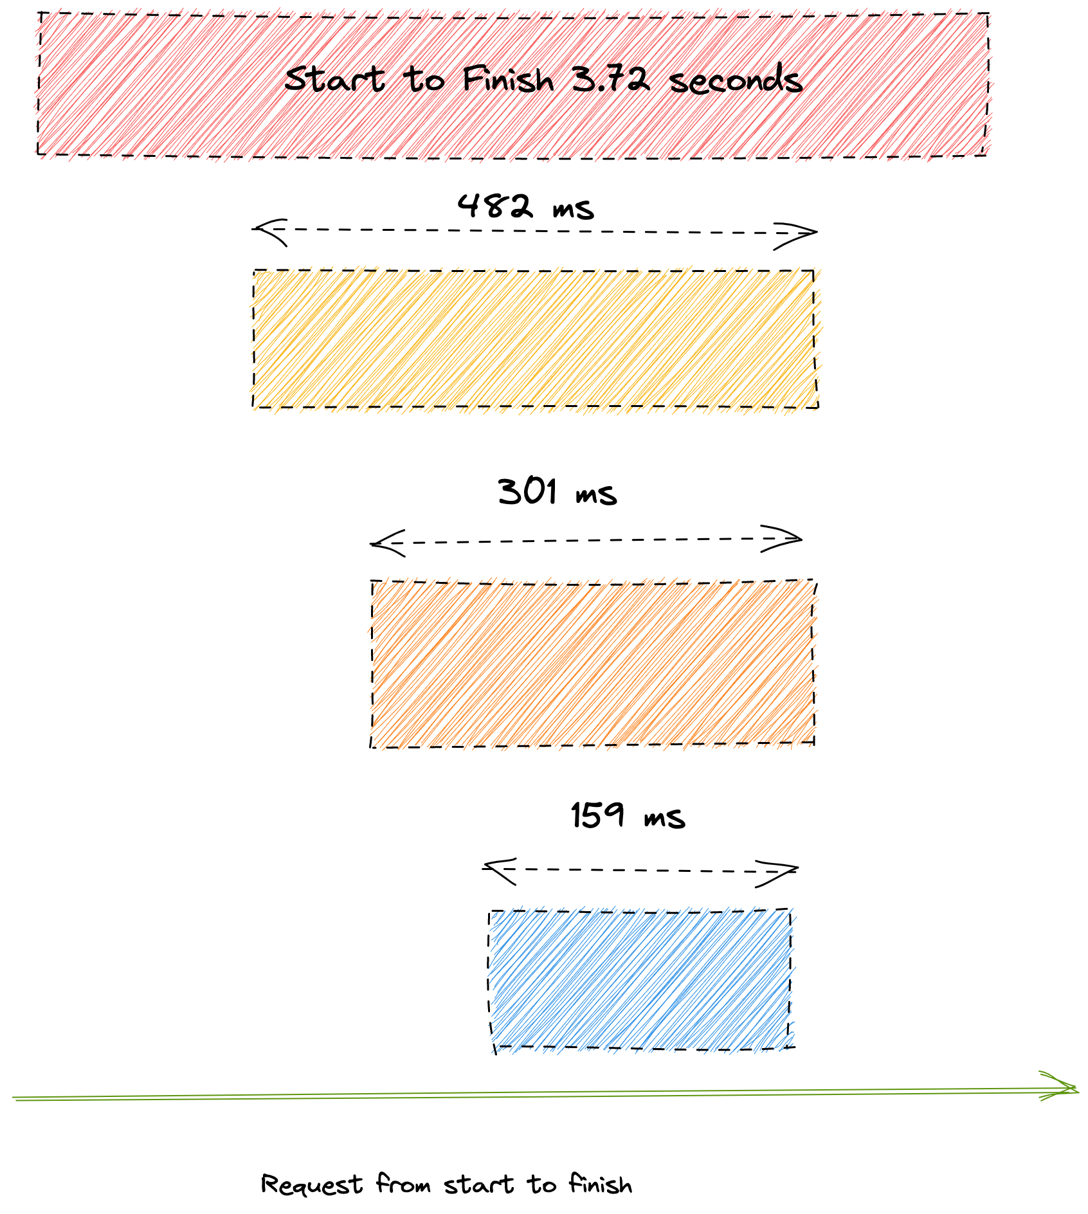
👉
👉
👉
👉

Slide 78
Trace_id =
4003964570065526982

Slide 79
span.setTag(
vehicle_reg,
“BXPB 5XG”)
span.setTag(
vehicle_reg,
“BXPB 5XG”)
span.setTag(
vehicle_sold,
true)

Slide 80
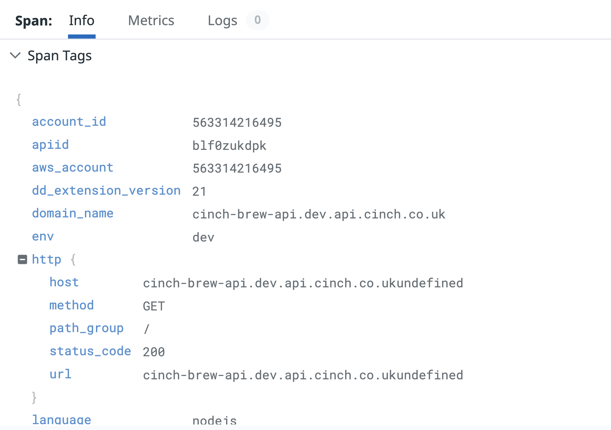
Span Context
👉
👉
👉

Slide 81
Span Context
Log Context

Slide 82
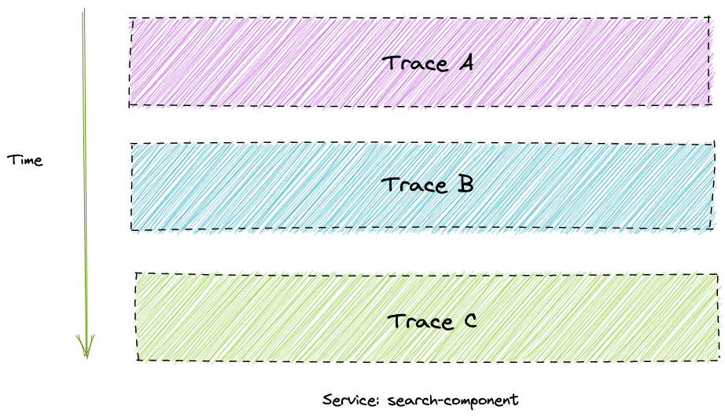
Across requests too!

Slide 83
A span
👉
👉
Another span
👉
Guess!

Slide 84
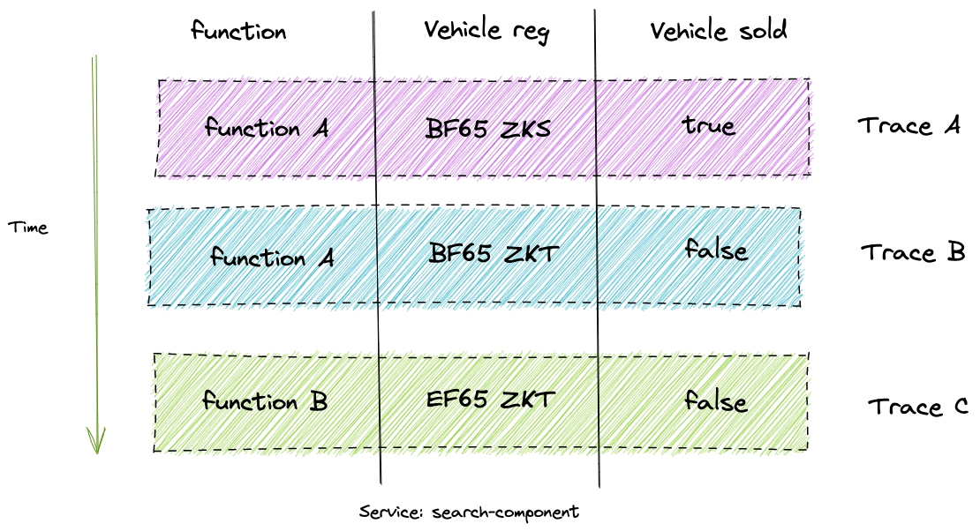
More than requests and traces

Slide 85
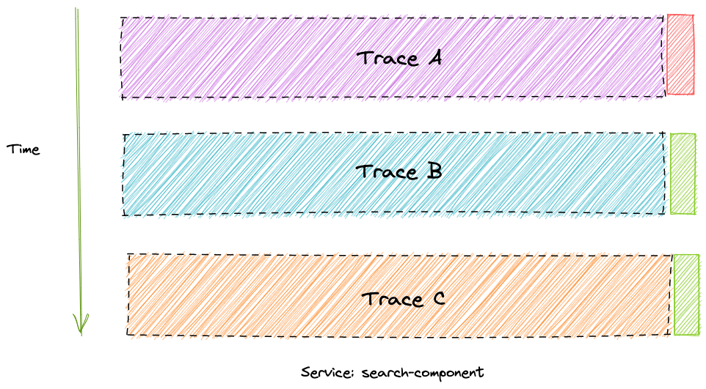
A failed span is a failed function invocation
❌

Slide 86
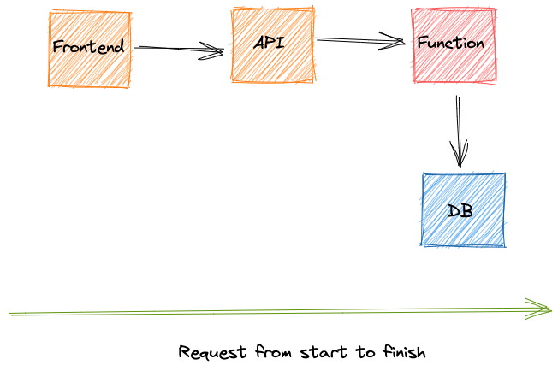
A failed span is a failed function invocation
❌
❌

Slide 87
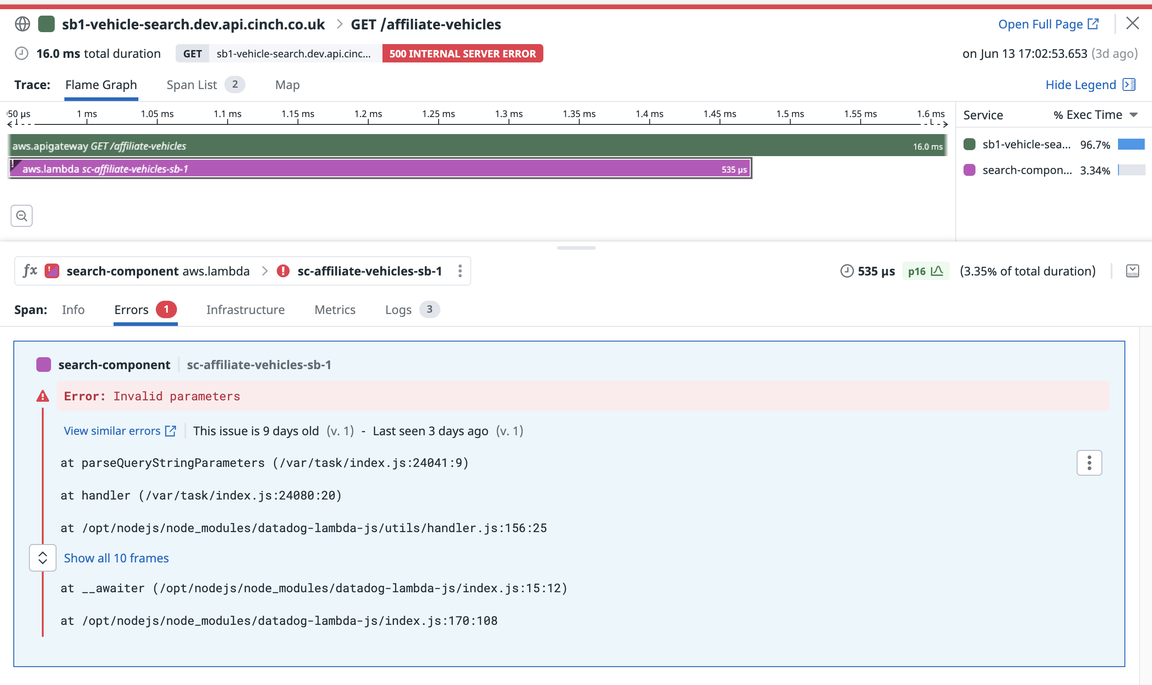
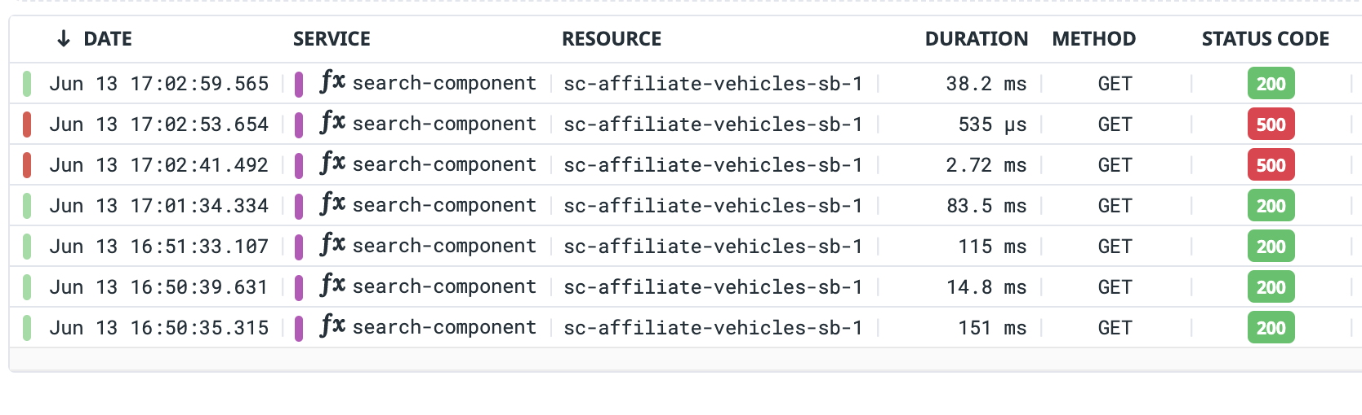
👉
👉
👉

Slide 88
So, why bother?
Notes:
. For example, Figure 4-4 indicates that the interaction between service C and service D was what took the longest. Traces, as such, largely help one understand the which and sometimes even the why (e.g., which component of a system is even touched during the lifecycle of a request and is slowing the response?).
The use cases of distributed tracing are myriad. While used primarily for inter service dependency analysis, distributed profiling, and debugging steady-state problems, tracing can also help with chargeback and capacity planning.

Slide 89
Notes:
Collecting this information and reconstructing the flow of execution while preserving causality for retrospective analysis and troubleshooting enables one to better understand the lifecycle of a request.

Slide 90
‘Hops’ across services
Notes:
Collecting this information and reconstructing the flow of execution while preserving causality for retrospective analysis and troubleshooting enables one to better understand the lifecycle of a request.

Slide 91
‘Hops’ across services
Amount of work + causality
Notes:
Collecting this information and reconstructing the flow of execution while preserving causality for retrospective analysis and troubleshooting enables one to better understand the lifecycle of a request.

Slide 92
‘Hops’ across services
Amount of work + causality
Request as a Trace
Notes:
Collecting this information and reconstructing the flow of execution while preserving causality for retrospective analysis and troubleshooting enables one to better understand the lifecycle of a request.

Slide 93
‘Hops’ across services
Dataset of spans
Request as a Trace
Notes:
Collecting this information and reconstructing the flow of execution while preserving causality for retrospective analysis and troubleshooting enables one to better understand the lifecycle of a request.

Slide 94
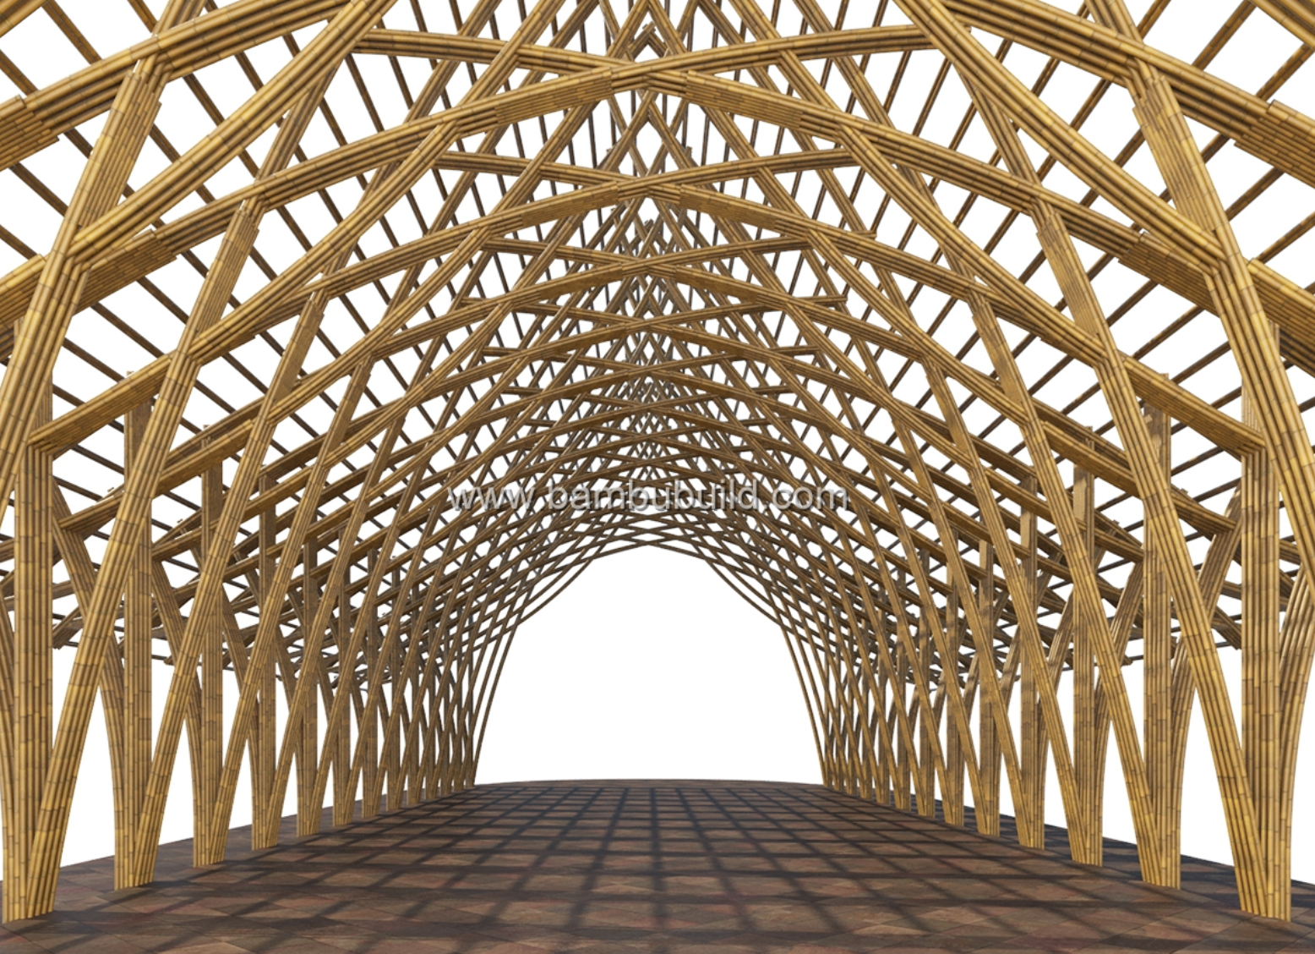
Notes:
Collecting this information and reconstructing the flow of execution while preserving causality for retrospective analysis and troubleshooting enables one to better understand the lifecycle of a request.

Slide 95
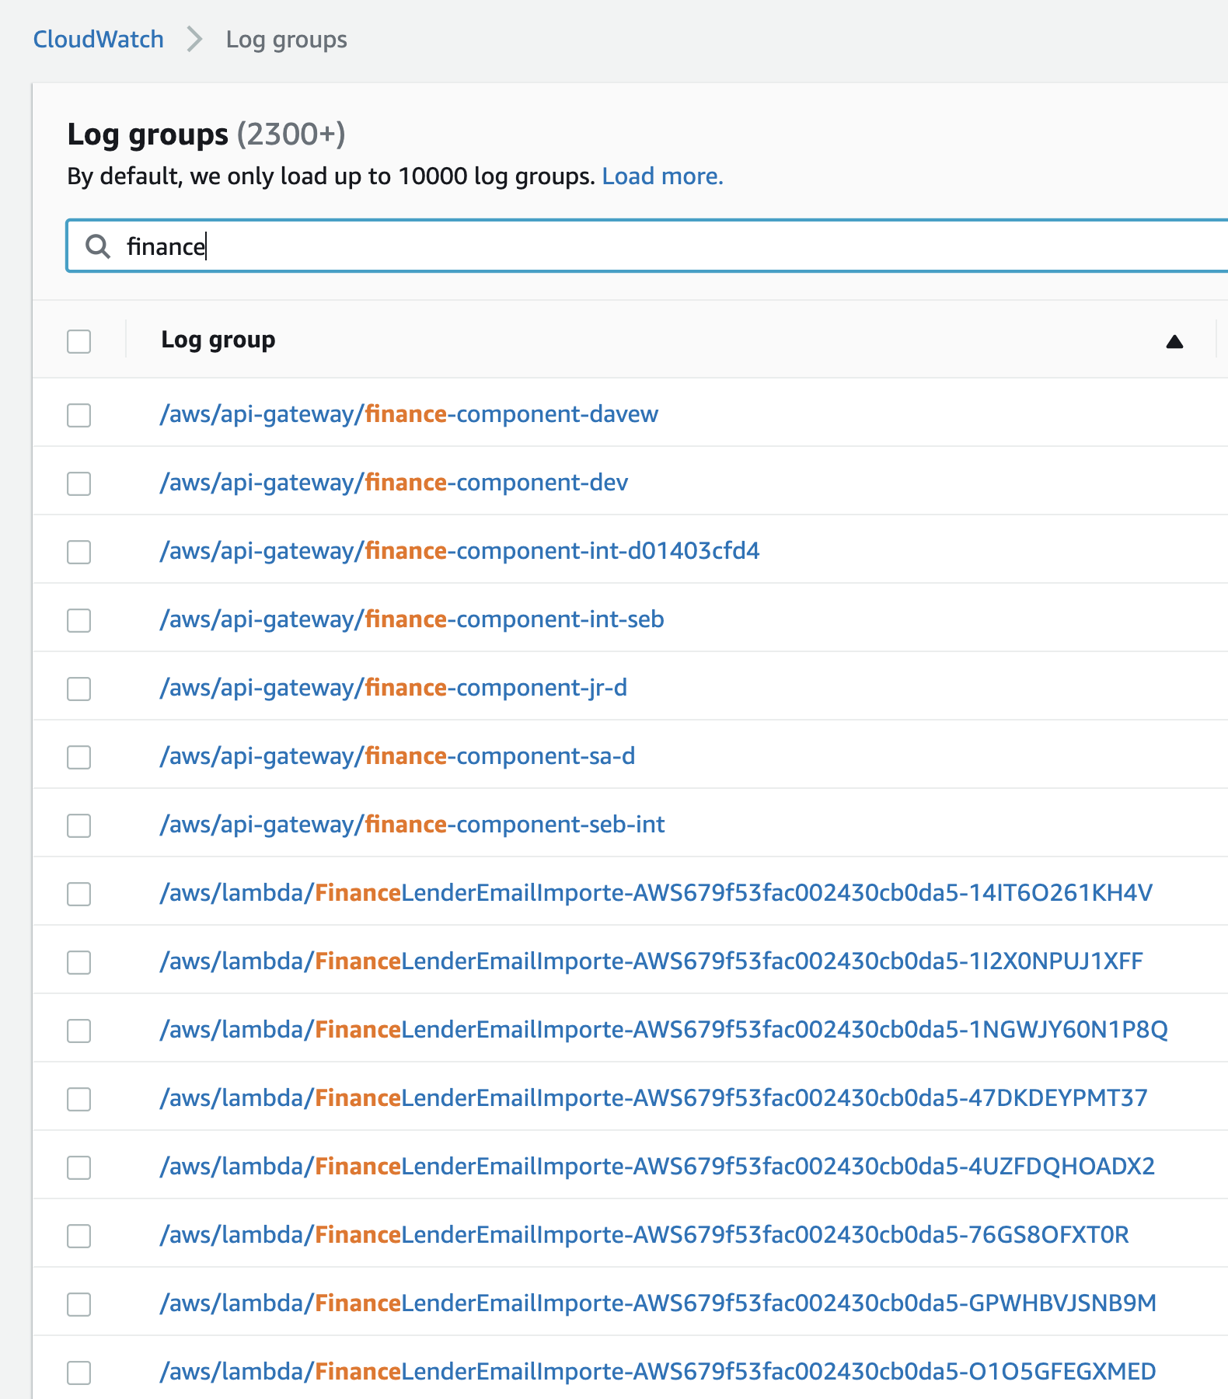
Notes:
Most importantly, having an understanding of the entire request lifecycle makes it possible to debug requests spanning multiple services to pinpoint the source of increased latency or resource utilization. For example, Figure 4-4 indicates that the interaction between service C and service D was what took the longest. Traces, as such, largely help one understand the which and sometimes even the why (e.g., which component of a system is even touched during the lifecycle of a request and is slowing the response?).

Slide 96
👉
👉
Notes:
Most importantly, having an understanding of the entire request lifecycle makes it possible to debug requests spanning multiple services to pinpoint the source of increased latency or resource utilization. For example, Figure 4-4 indicates that the interaction between service C and service D was what took the longest. Traces, as such, largely help one understand the which and sometimes even the why (e.g., which component of a system is even touched during the lifecycle of a request and is slowing the response?).

Slide 97


Slide 98
Drawbacks of tracing
Notes:
Collecting this information and reconstructing the flow of execution while preserving causality for retrospective analysis and troubleshooting enables one to better understand the lifecycle of a request.
Most importantly, having an understanding of the entire request lifecycle makes it possible to debug requests spanning multiple services to pinpoint the source of increased latency or resource utilization. For example, Figure 4-4 indicates that the interaction between service C and service D was what took the longest. Traces, as such, largely help one understand the which and sometimes even the why (e.g., which component of a system is even touched during the lifecycle of a request and is slowing the response?).
The use cases of distributed tracing are myriad. While used primarily for inter service dependency analysis, distributed profiling, and debugging steady-state problems, tracing can also help with chargeback and capacity planning.

Slide 99
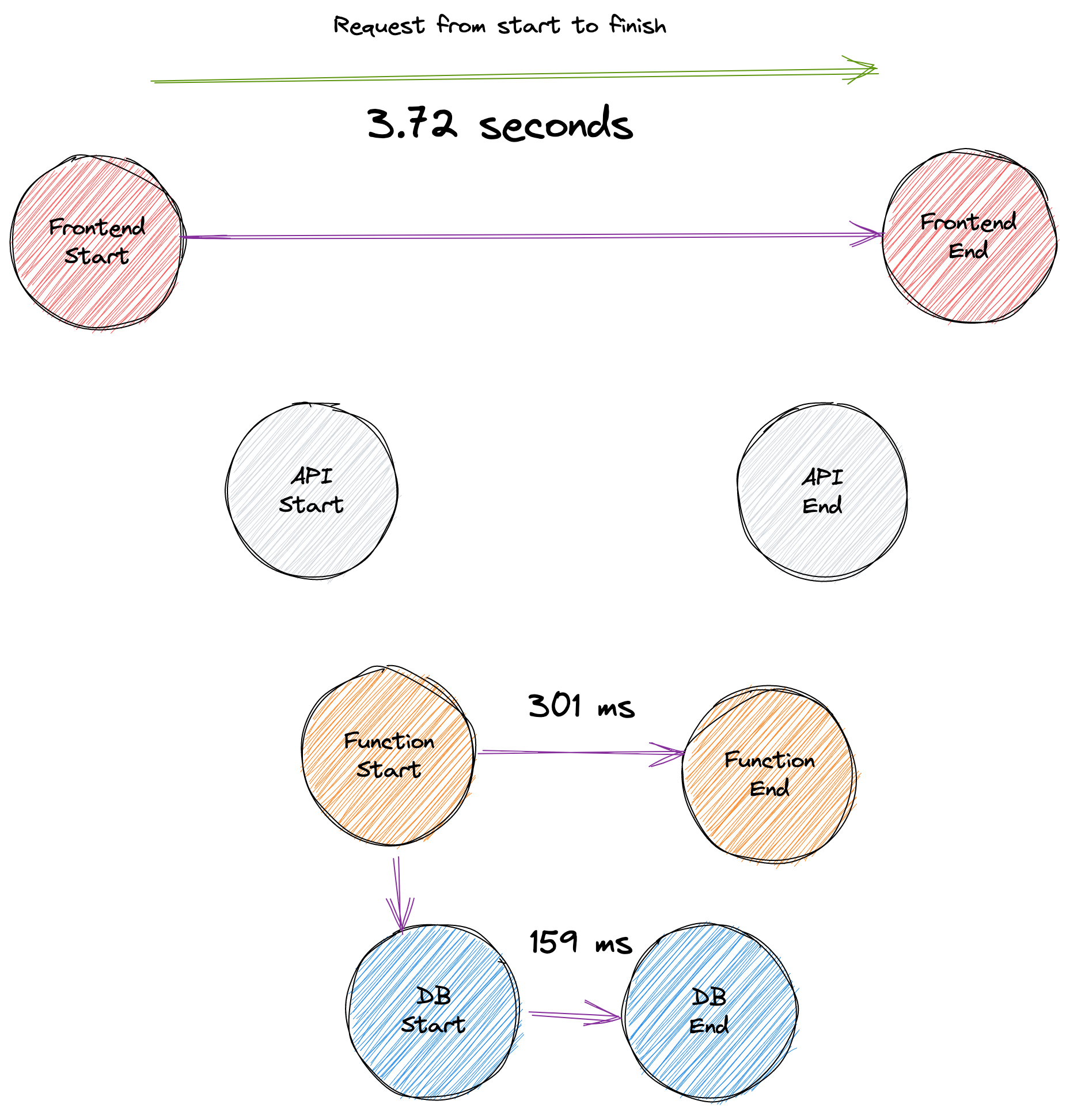
Components in request not traced
Notes:
Collecting this information and reconstructing the flow of execution while preserving causality for retrospective analysis and troubleshooting enables one to better understand the lifecycle of a request.
Most importantly, having an understanding of the entire request lifecycle makes it possible to debug requests spanning multiple services to pinpoint the source of increased latency or resource utilization. For example, Figure 4-4 indicates that the interaction between service C and service D was what took the longest. Traces, as such, largely help one understand the which and sometimes even the why (e.g., which component of a system is even touched during the lifecycle of a request and is slowing the response?).
The use cases of distributed tracing are myriad. While used primarily for inter service dependency analysis, distributed profiling, and debugging steady-state problems, tracing can also help with chargeback and capacity planning.

Slide 100
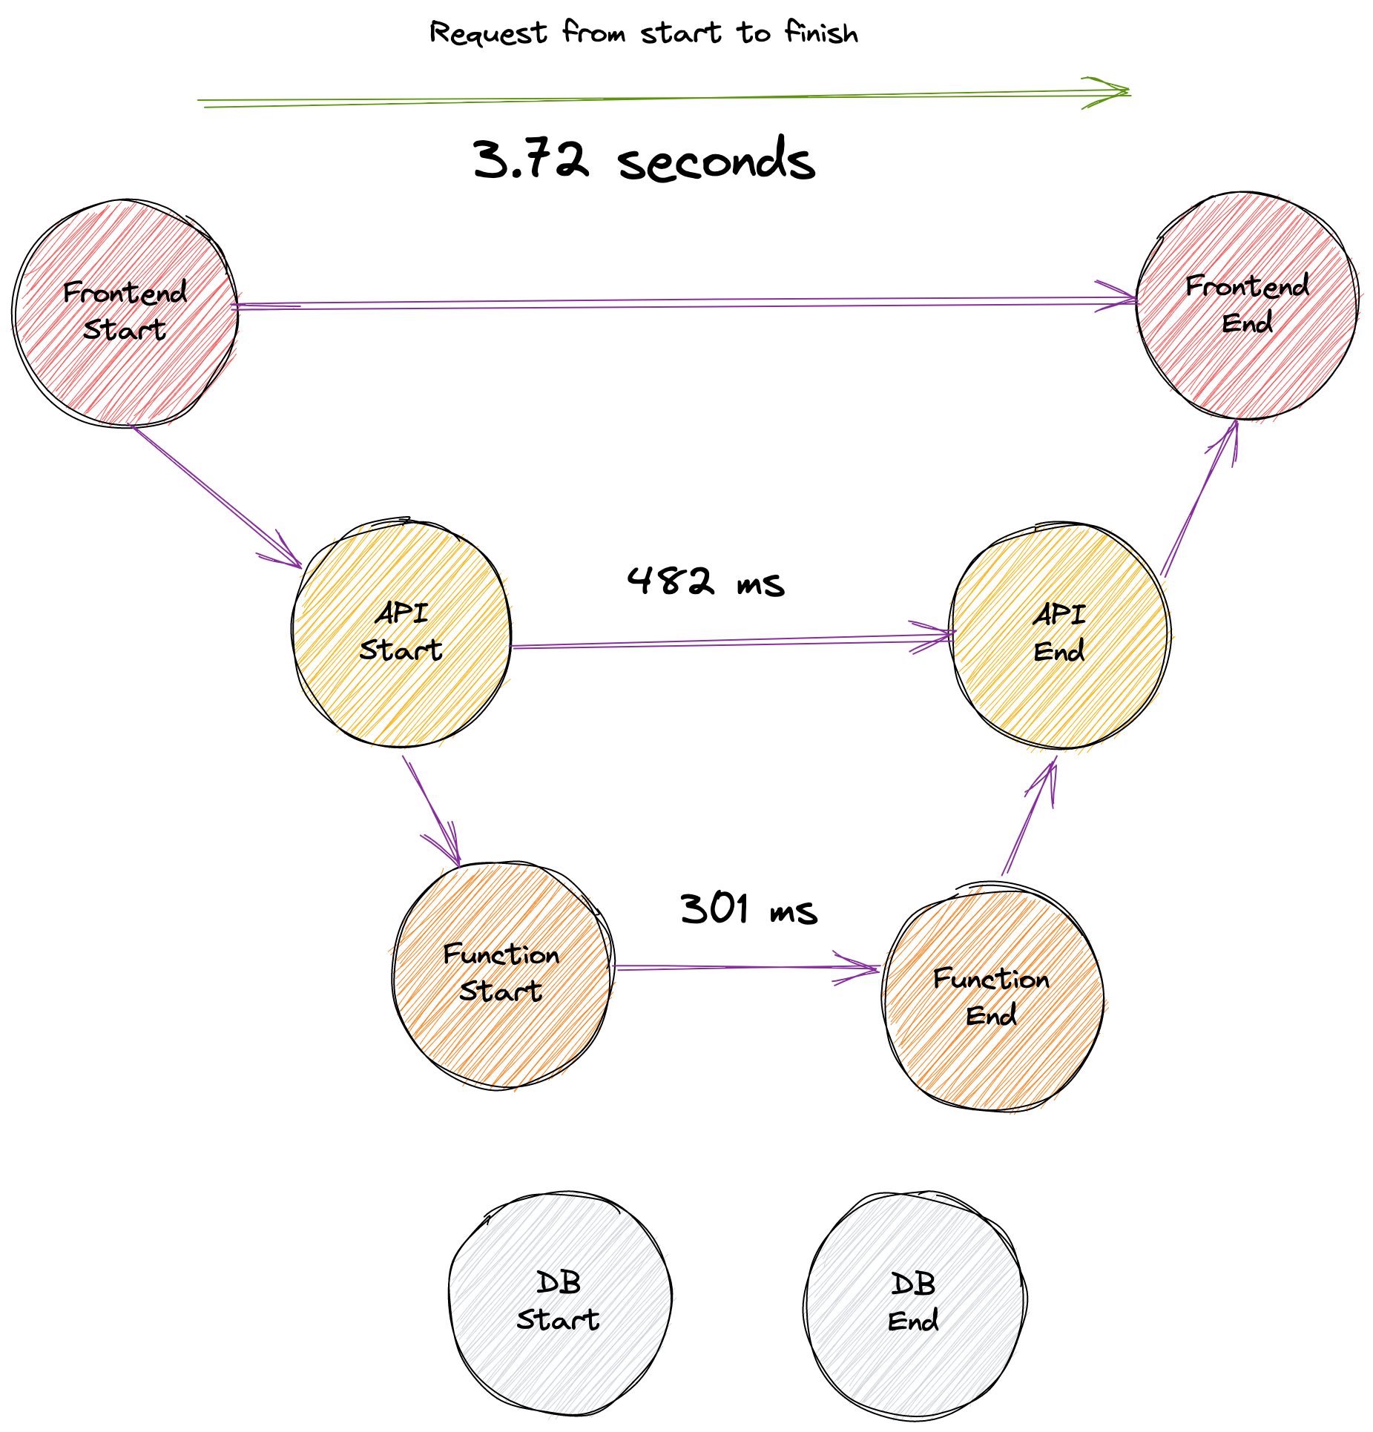
3rd party components not traced
Notes:
Collecting this information and reconstructing the flow of execution while preserving causality for retrospective analysis and troubleshooting enables one to better understand the lifecycle of a request.
Most importantly, having an understanding of the entire request lifecycle makes it possible to debug requests spanning multiple services to pinpoint the source of increased latency or resource utilization. For example, Figure 4-4 indicates that the interaction between service C and service D was what took the longest. Traces, as such, largely help one understand the which and sometimes even the why (e.g., which component of a system is even touched during the lifecycle of a request and is slowing the response?).
The use cases of distributed tracing are myriad. While used primarily for inter service dependency analysis, distributed profiling, and debugging steady-state problems, tracing can also help with chargeback and capacity planning.

Slide 101
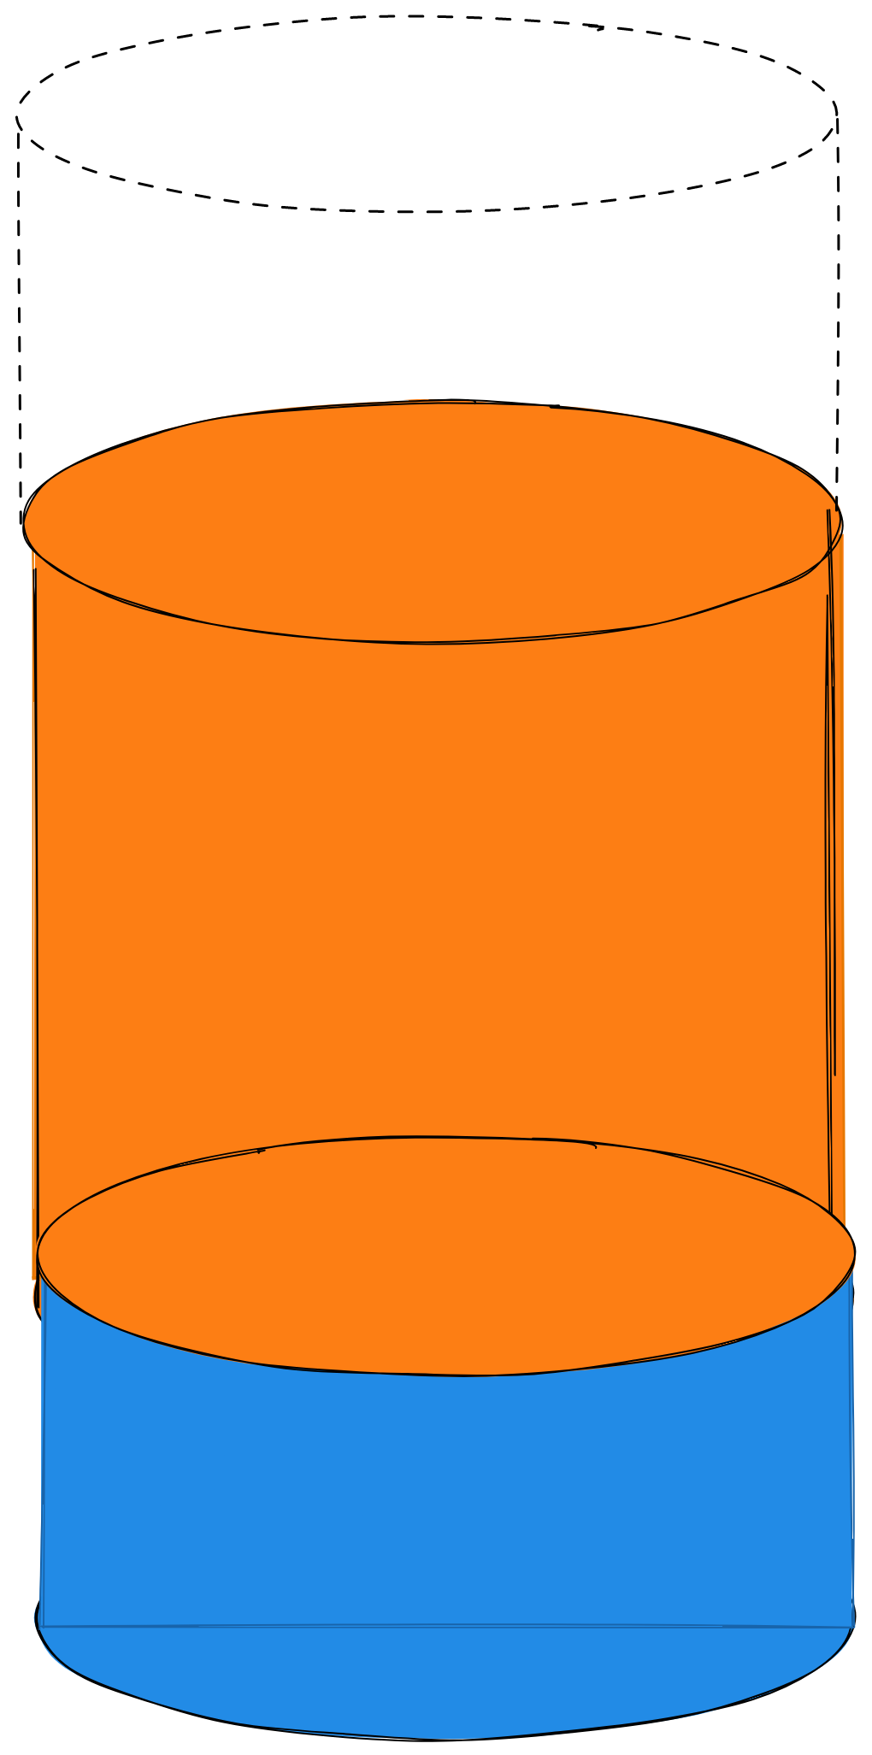
Cognitive (observability) Load
Thinking
Tracing
Logs

Slide 102
So, am I banking too much on tracing?

Slide 103
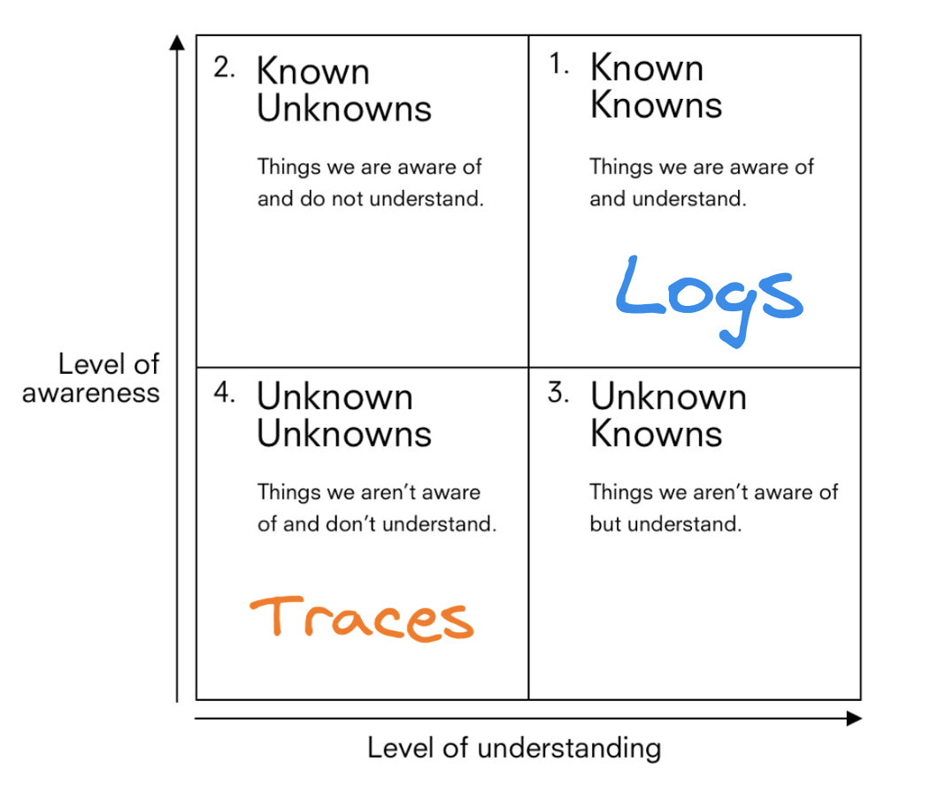


Slide 104
Conclusion

Slide 105
Logs
👉
👉
3 pillars
Events

Slide 106
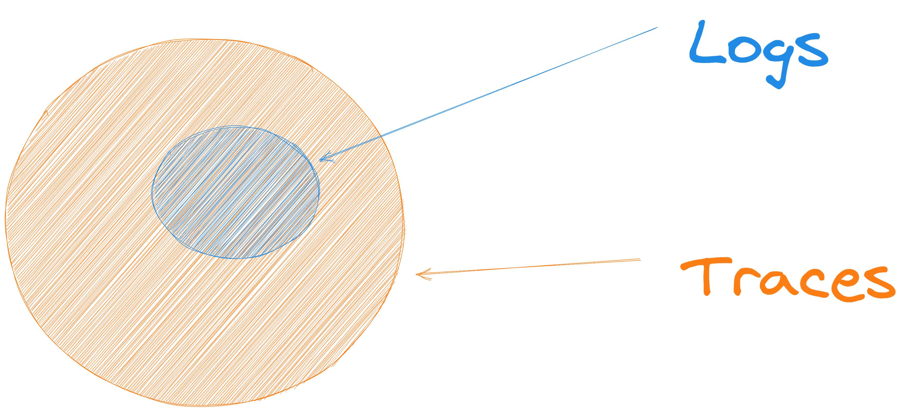
Traces are a superset of Logs

Slide 107
Logs are built for monoliths.

Slide 108
Traces are built for distributed systems.

Slide 109
You will start seeing the unknown unknowns all over the place.

Slide 110
Thanks!

Slide 111
